Slide 1
Native Git Commands
Commands you can use in GitBash

Slide 2
Clone Repo
Place new file into local repo
Remove file from local repo
Check status
Check diff between 2 versions of the same file
Commit changes
Push
Pull
Create/Switch branches
Revert

Slide 3
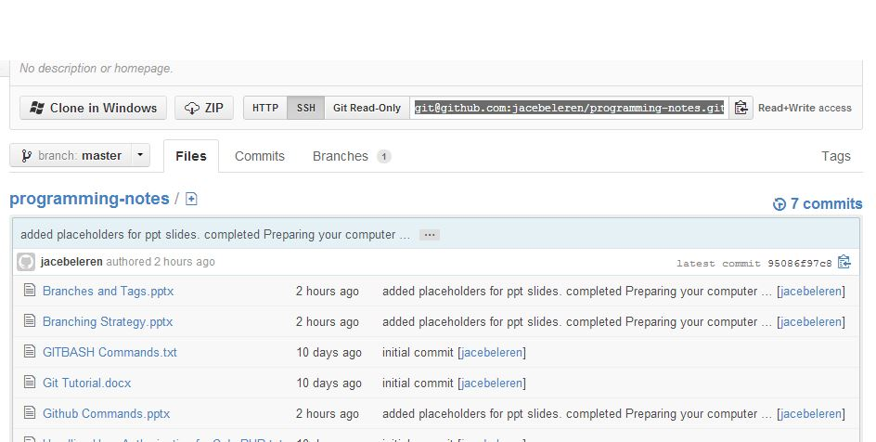
Clone Repo
In order to clone someone’s repository on GitHub, you’ll first need to get the SSH or HTTP link for the repository you want to clone.

Slide 4
Clone Repo
Once you’ve copied that, go to GitBash.
Navigate to your project space and type
git clone <link>
Fill in the <link> part with the link you copied and press Enter.
If you’ve set up the connection to use SSH keys, then GitBash will prompt you for you passphrase. If not, it will ask for your GitHub username and password.

Slide 5
Place new file into local repo
When you create a new file in your project folder, git will notice it, but will not keep track of it. In order to make git start tracking the file, you need to type:
git add <file name>
Just replace the <file name> part with your new file, and git will start tracking it. If your file is in a sub-folder, you’ll need to put the path to the file instead of just the file name.

Slide 6
Place new file into local repo
If you have multiple files that you want to add all at once, you can type
git add . or git add –a
Now git will add every single new file it locates within your project folder and sub-folders and start tracking their changes.

Slide 7
Remove file from local repo
Sometimes you may want to remove a file from being tracked. In order to do so, type
git rm <file name>
Similar to adding a file, you’ll need to specify the name of the file to be removed. If it’s in a sub-folder, you need to specify the whole path.

Slide 8
Check status
Checking the status of your project is very useful. You can see all the files that have changed and what files or folders have been added or removed. To do that, type
git status

Slide 9
Check diff between 2 versions of the same file
If you want to check the difference between 2 versions of the same file, type
git diff --cached

Slide 10
Commit changes
You will need to commit changes before you can push them to the git repo server. Type this in GitBash
git commit -a or git commit *
This command will commit all changes that were added with git add.

Slide 11
Push
Once you’re satisfied with your commits, you can push them to the server with this:
git push
If you’ve set a passphrase for ssh keys, you’ll need to type in that passphrase. If you didn’t set a passphrase, then just hit Enter. Otherwise, GitBash will prompt you for your GitHub username (email) and password.

Slide 12
Push
This may not work the very fist time you push, because GitBash isn’t sure where you want to push to. If this happens, type
git push <repo> <branch name>
Replace <repo> with your repository name (default should be ‘origin’) and <branch name> with the branch you’re working on (most likely ‘master’ or ‘develop’)

Slide 13
Pull
If you’re working in a team, your team mates may have pushed their code to the server. When this happens, GitBash won’t allow you to push your code until you’ve pulled the most recent changes. Just type
git pull
As with push, you may need to put a <repo> and a <branch name>.

Slide 14
Create/Switch Branches
There will be a section on Branches later on, but here is command to switch branches first:
Replace the <branch> part with the name of the branch you want to switch to. If you want to create a new branch instead, add "-b" between "checkout" and "<branch>", like so:
git checkout <branch>
git checkout -b <branch>

Slide 15
Revert
If you ever need to revert back to a previous commit, you can do so by typing
git revert <checksum>
Of course, you’ll need to find the checksum that marks the commit you want to revert to.

